Slide 1
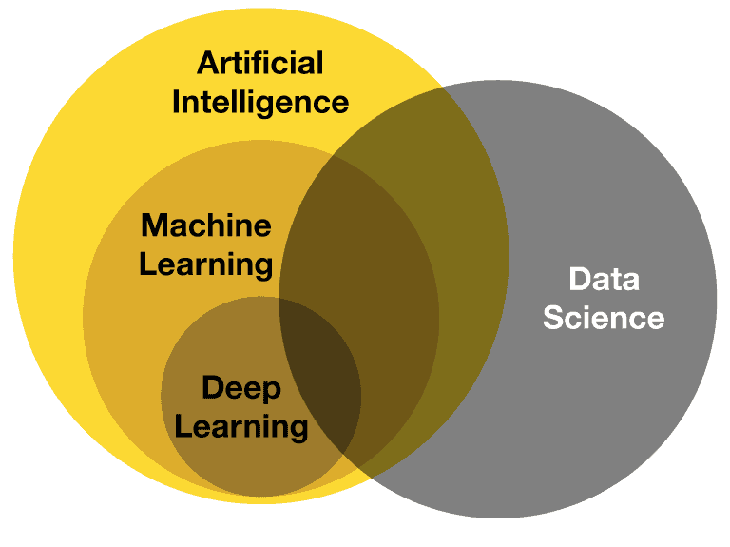
INTRODUCTION to machine learning

Slide 2
machine learning
Machine learning a branch of artificial intelligence, is about the construction and study of systems that can learn from data.
Machine Learning can impower computers learn and behave more intelligently.
Machine learning explore algorithms/build model:
Learn from data.
Use the model for prediction, decision making or solving some task.

Slide 3
machine learning
+
+
+
=

Slide 4
machine learning
For example, a machine learning system could be trained on email messages to learn to distinguish between spam and non-spam messages. After learning, it can then be used to classify new email messages into spam and non-spam folders.
There is a wide variety of machine learning tasks and successful applications. Optical character recognition, in which printed characters are recognized automatically based on previous examples, is a classic example of machine learning.

Slide 5
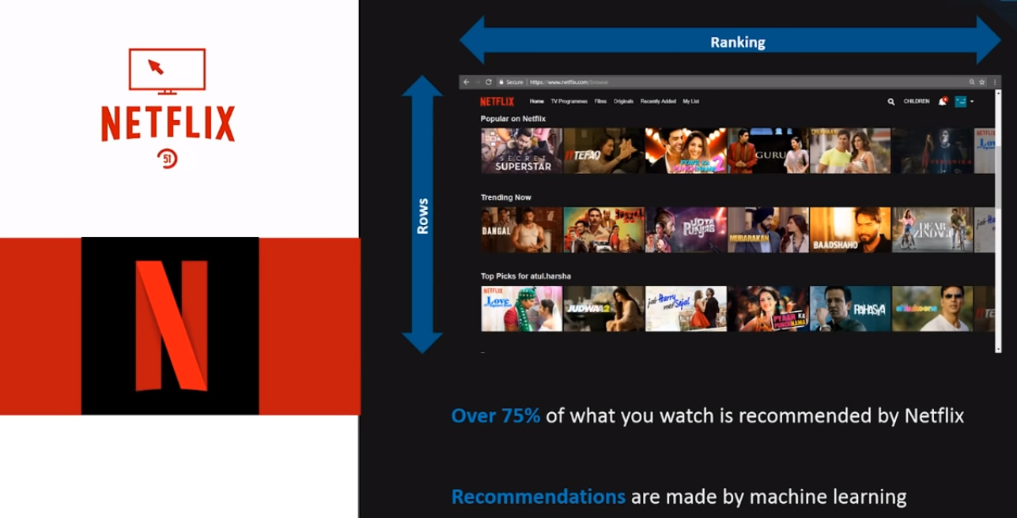
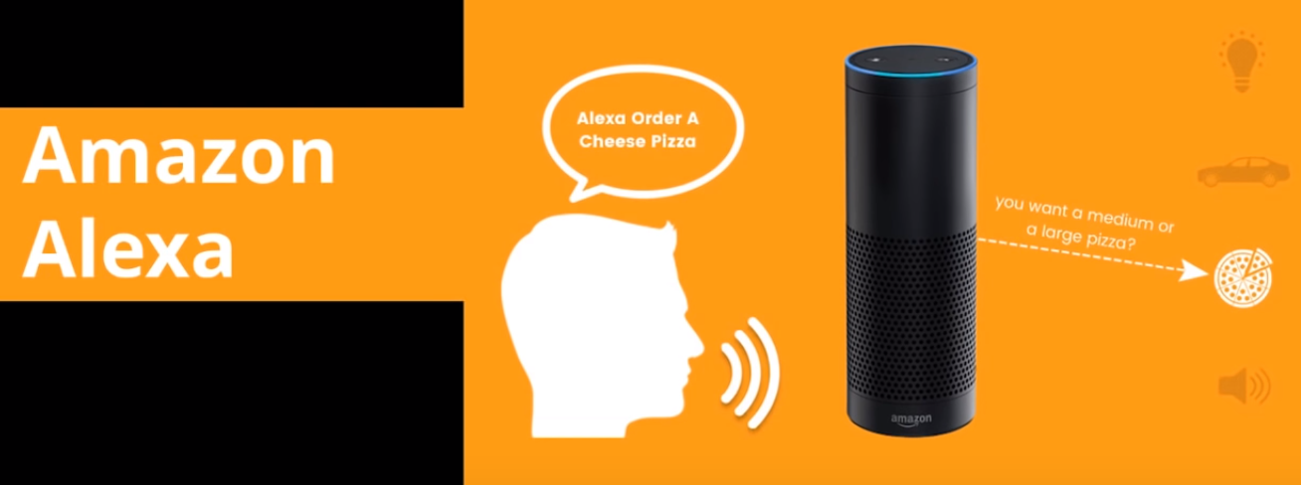
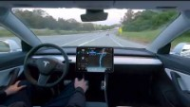
Real life examples
2
3
1

Slide 6
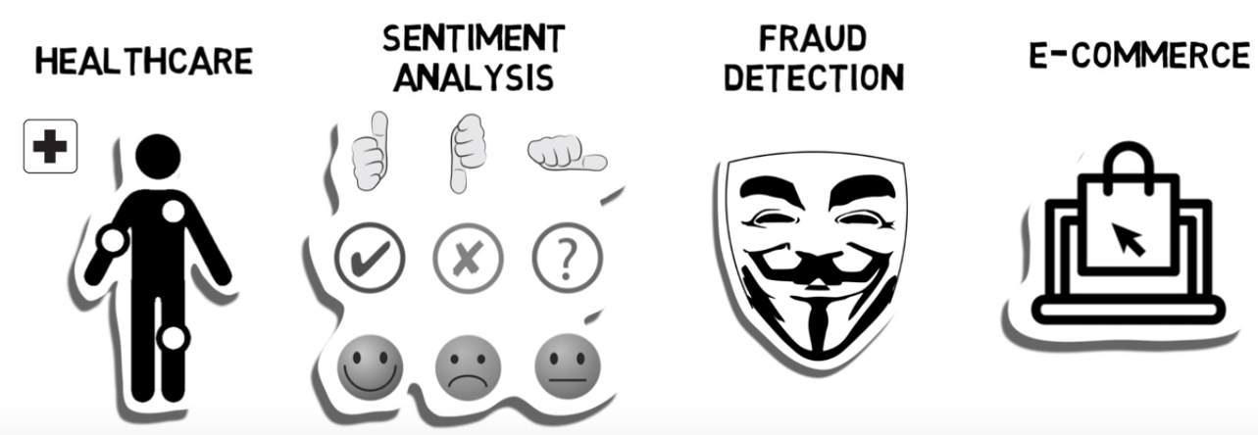
Application of machine learning

Slide 7
Types of machine learning
Machine Learning
Supervised
Learning
Unsupervised
Learning
Reinforcement
Learning

Slide 8
Supervised learning
In supervised learning, we need something called a Labelled Training Dataset.
In supervised learning, a labeled training dataset with the correct responses is provided, and based on this training dataset, the algorithm generalizes to respond correctly to all possible inputs.

Slide 9
Supervised learning
CAR
CAR
Training
Dataset
=
+
=
f ( , )
CAR
BIKE
BIKE
Samples
Labels

Slide 10
Classification
Elephant
Classifier
Elephant
Tiger
Dataset

Slide 11
regression
f ( , )
10400.00
=
Dataset

Slide 12
regression
If the possible output values of the function are continuous real values, then it is called Regression.
The Classification and Regression problems are supervised, because the decision depends on the characteristics of the ground truth labels or values present in the dataset, which is defined as experience.

Slide 13
unsupervised learning
In unsupervised learning, correct responses are not provided.
The algorithm tries to identify similarities between the inputs so that inputs that have something in common are categorized together.
The task is to identify the patterns like group the similar objects together.

Slide 14
unsupervised learning
Dataset
Clustering
Samples

Slide 15
reinforcement learning
It is also known as learning from trials and errors.

Slide 16
reinforcement learning
Baby learn from the trials and errors.
Punishment
Reward

